Slide 1
Towards Attesting Multi-TEE Devices

Slide 2
High-Order Bits
Multiple low-level technologies
Great variety of possible device compositions
Comprehensive yet complex protocol stack
Significant latitude in implementation
Significant degree of ambiguity
Ownership and functionality straddles different standards bodies
Untapped well of red team potential
RATS WG would do well to collaborate with PCI-SIG and DMTF organizations

Slide 3
Problem Description
Machines undergoing attestation are increasingly composed of several TEE-capable components (CPU + peripherals)
These components typically talk to each other over (historically cleartext) PCIe
Legacy PCIe lacks a trustworthy channel that is safe from snooping as well as logical and physical interference
Say a device happens to be made up of secure components – how would it convince outside parties of that fact?
… and be able to do it on demand, even as device composition changes (e.g., hot swaps)
… and account for the vagaries of the supply chain

Slide 4
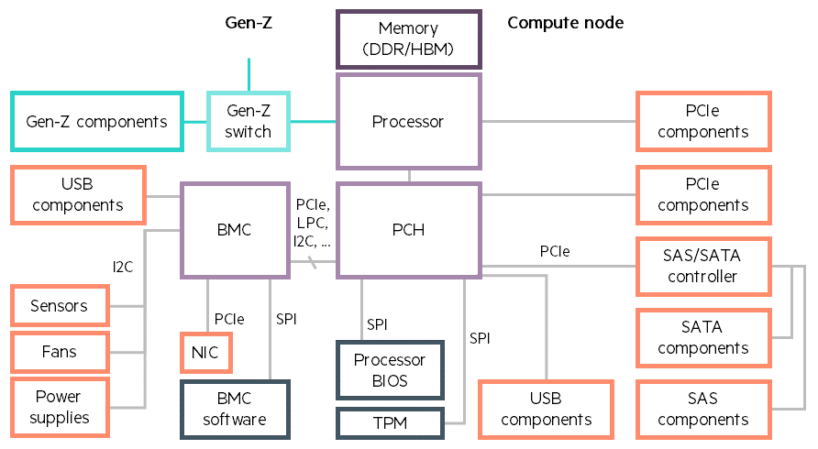
System Construction
Multiple interconnect types (PCIe, I2C, SPI, DDR, …)
All use security data objects developed by the DMTF
Any interconnect can be used to transport these security data objects for authentication, verification, and key-exchange

Slide 5
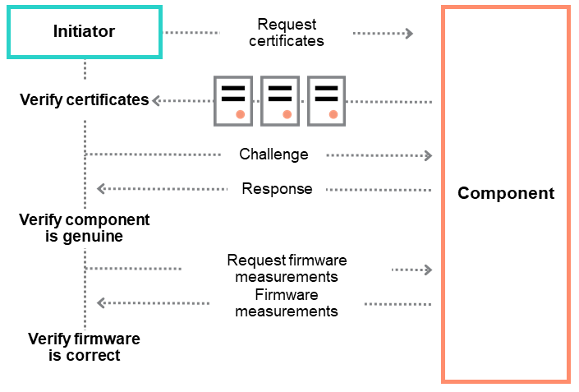
Five Phases of a Component’s Lifecycle
Component manufacturing
Each component needs to be authenticatable at any time during the manufacturing process by an appropriate test device. This allows the authenticity of a component (including all parts included in its assembly) to be verified at any point while in the supply chain.
Component integration
Prior to installing a component in an enclosure or an enclosure into a rack or larger enclosure, the integrator or manufacturer needs to verify its authenticity.
Initialization and power cycle events
Authentication needs to be performed whenever a component or enclosure is initialized or power cycled.
Runtime
Authentication needs to be performed on-demand to support application or customer-specific validation prior to or during application or service operation. Further, authentication needs to be initiated whenever a component exits a deep low-power state.
Component addition or replacement
Authentication needs to be performed whenever a component is added or replaced.

Slide 6
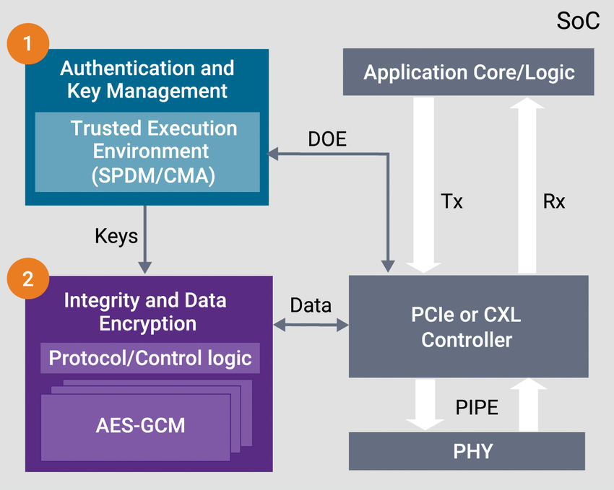
Protocol Stack
Security Protocol and Data Model – SPDM (DSP 0274)
Integrity and Data Encryption (IDE)
Component Measurement & Authentication (CMA)
DMTF – Distributed Management Task Force
SPDM defines a toolkit for authentication, measurement, and other security capabilities
CMA defines how SPDM is applied to PCIe devices and systems
DOE supports Data Object transport between host CPUs & PCIe components over PCIe
Various MCTP bindings support Data Object transport over different interconnects
IDE will typically use this toolkit for key exchange, but can use other mechanisms for keys
IDE key programming protocol
SPDM over MCTP Binding (DSP 0275)
Data Object Exchange (DOE)
Secured MCTP Messages over MCTP Binding (DSP 0276)
MCTP over SMBus Binding (DSP 0237)
MCTP over PCIe Binding (DSP 0238)
DMTF
PCI-SIG

Slide 7
PCIe IDE (Integrity and Data Encryption)
Requirements
Protect against supply chain attacks, physical attacks, persistent attacks, malicious components, …
Secure entire component lifecycle – manufacturing, installation, initialization, operation, addition & replacement
Goals
Provide confidentiality, integrity, reorder and replay protection for PCIe Transaction Layer Packets (TLPs)
Deliver a “composed TEE” model

Slide 8
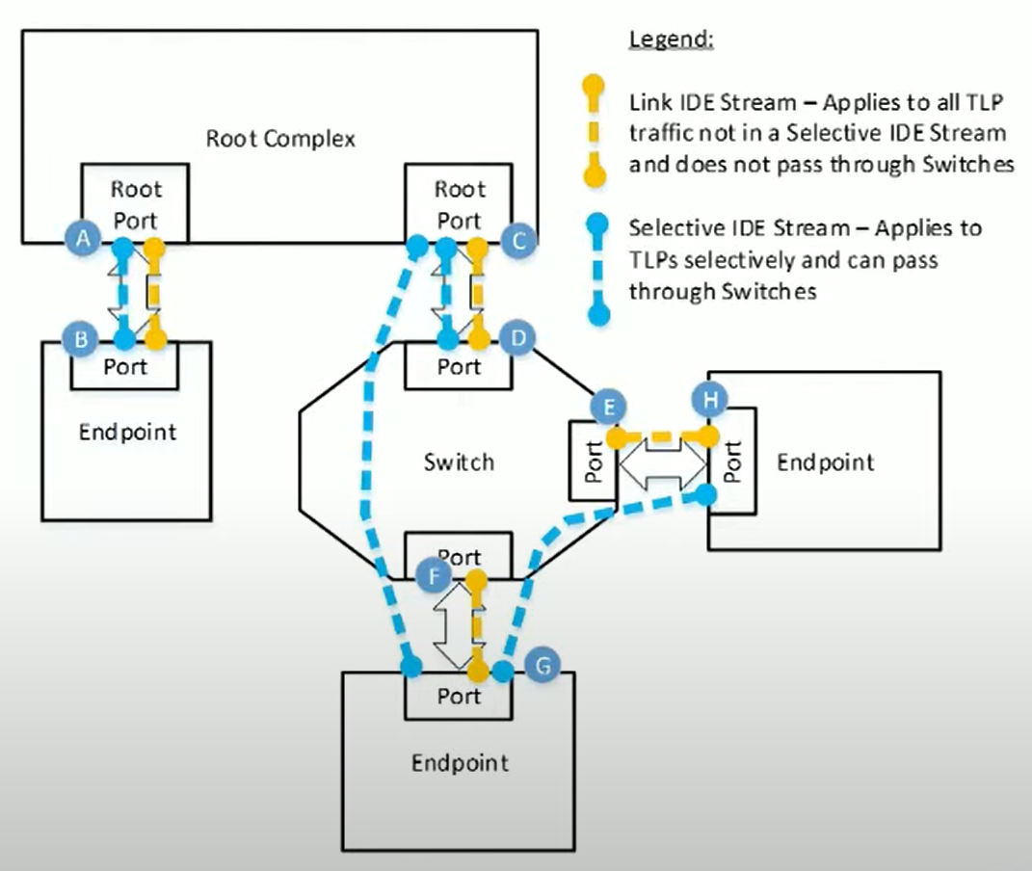
IDE Protection Overview
IDE establishes IDE stream between two ports; security is port-to-port
Link IDE stream – applies to all TLP traffic not in a selective IDE stream
Selective IDE stream – applies to TLPs selectively
Selective IDE can pass through switches
IDE protection stops at the port boundary
TLP transmission is considered “reliable”…
Error in transmission – system is under attack

Slide 9
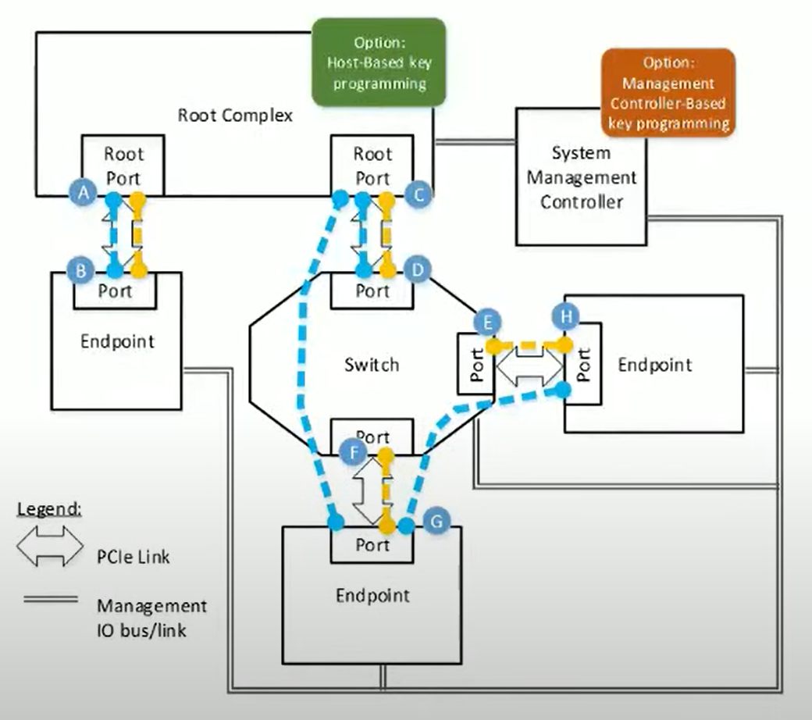
Options for Key Programming
How are keys managed?
How do you handle authentication in relation to keys?
Sometimes known by system construction (e.g., in embedded systems) → components authenticated implicitly
But also support a runtime mechanism to confirm the authenticity and integrity of the component
Possible to program new keys either once at startup (“set and forget”) or through hot plug, including for virtualized systems when security requirements change

Slide 10
How to Verify Compliance?
“Verifier” implementation is key
Build on CMA/SPDM foundation
Key programming protocol coordinated with SPDM 1.2
Outside PCIe Base specification
System level policies expected to vary radically
Certificate provisioning and exchange are documented, but metadata conveyed inside certificates seems to be wide open – hard to make sense of
TEEs may nest like Russian dolls – how to orchestrate re-attestation at runtime?
Device requirements parallel those of the host
Even simple devices must implement foundational security within themselves (securing keys, debug mechanisms, …)
Components inside a composite device may themselves be at varying levels of security

Slide 11
References
ECN Deep Dive: https://pcisig.com/sites/default/files/files/PCIe%20Security%20Webinar_Aug%202020_PDF.pdf
Same but on YouTube: https://youtu.be/XWftNeNJHnE?t=83
PCIe Component Authentication: https://pcisig.com/pcie%C2%AE-component-authentication
TEEs and the Responsibilities of a Secure Device: https://pcisig.com/trusted-execution-environments-tees-and-responsibilities-secure-device
Protecting Data over PCIe & CXL in Cloud Computing: https://www.synopsys.com/designware-ip/technical-bulletin/security-ide-ip.html
Linux Plumbers Conference on DOE/CMA/SPDM: https://lpc.events/event/11/contributions/1089/attachments/766/1440/DOE%20CMA%20SPDM%20Plumbers%20v5.pdf
OCP 2020 Tech Week: Measurement & Attestation: https://youtu.be/PrkCQTEhb7Y
SPDM 1.2 Overview: https://www.dmtf.org/sites/default/files/SPDM_1.2_Overview.pdf

